Slide 1
Analyze Data on List Pages
Public preview
Business Central
2023 release wave 1

Slide 2
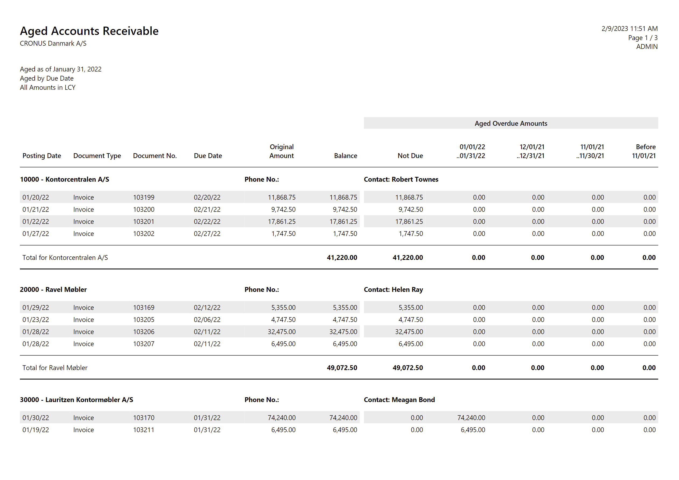
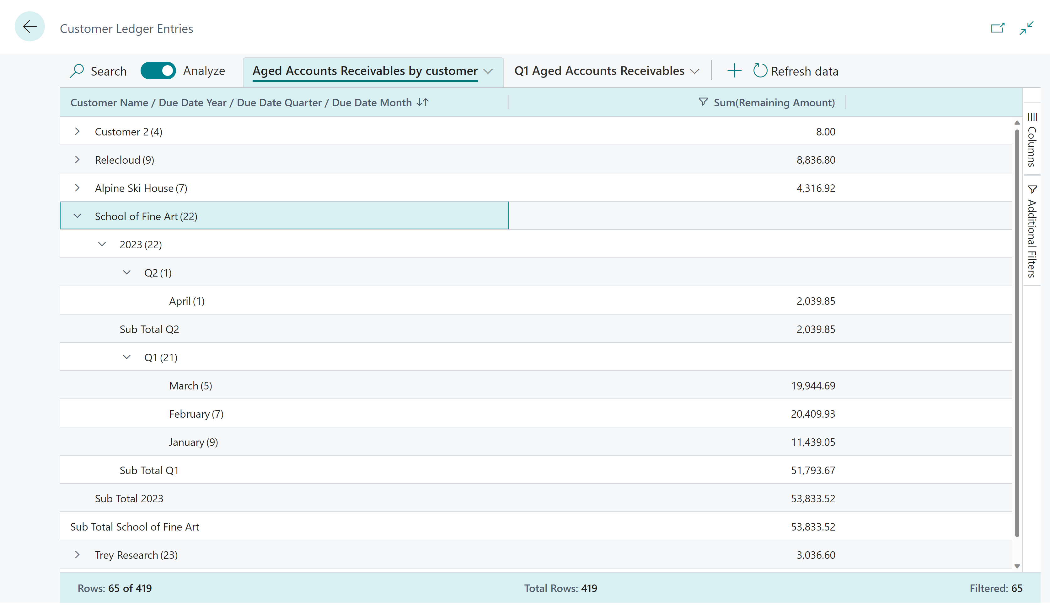
Analyse Data on List Pages is…
Before (run a report, get a PDF)
Now (self-service data analysis)

Slide 3
With Analyse Data on List Pages, you can
Quickly extract insights from your data directly in Business Central with no need to involve developers.
Design data your way: For each analysis,
Pick columns, reorder them, freeze left/right
Set additional data filters
Group and pivot
Mark cells and do some quick fact checking
Copy some/all data, import to Excel/PowerPoint/…
Save your analysis for repetitive use.

Slide 4
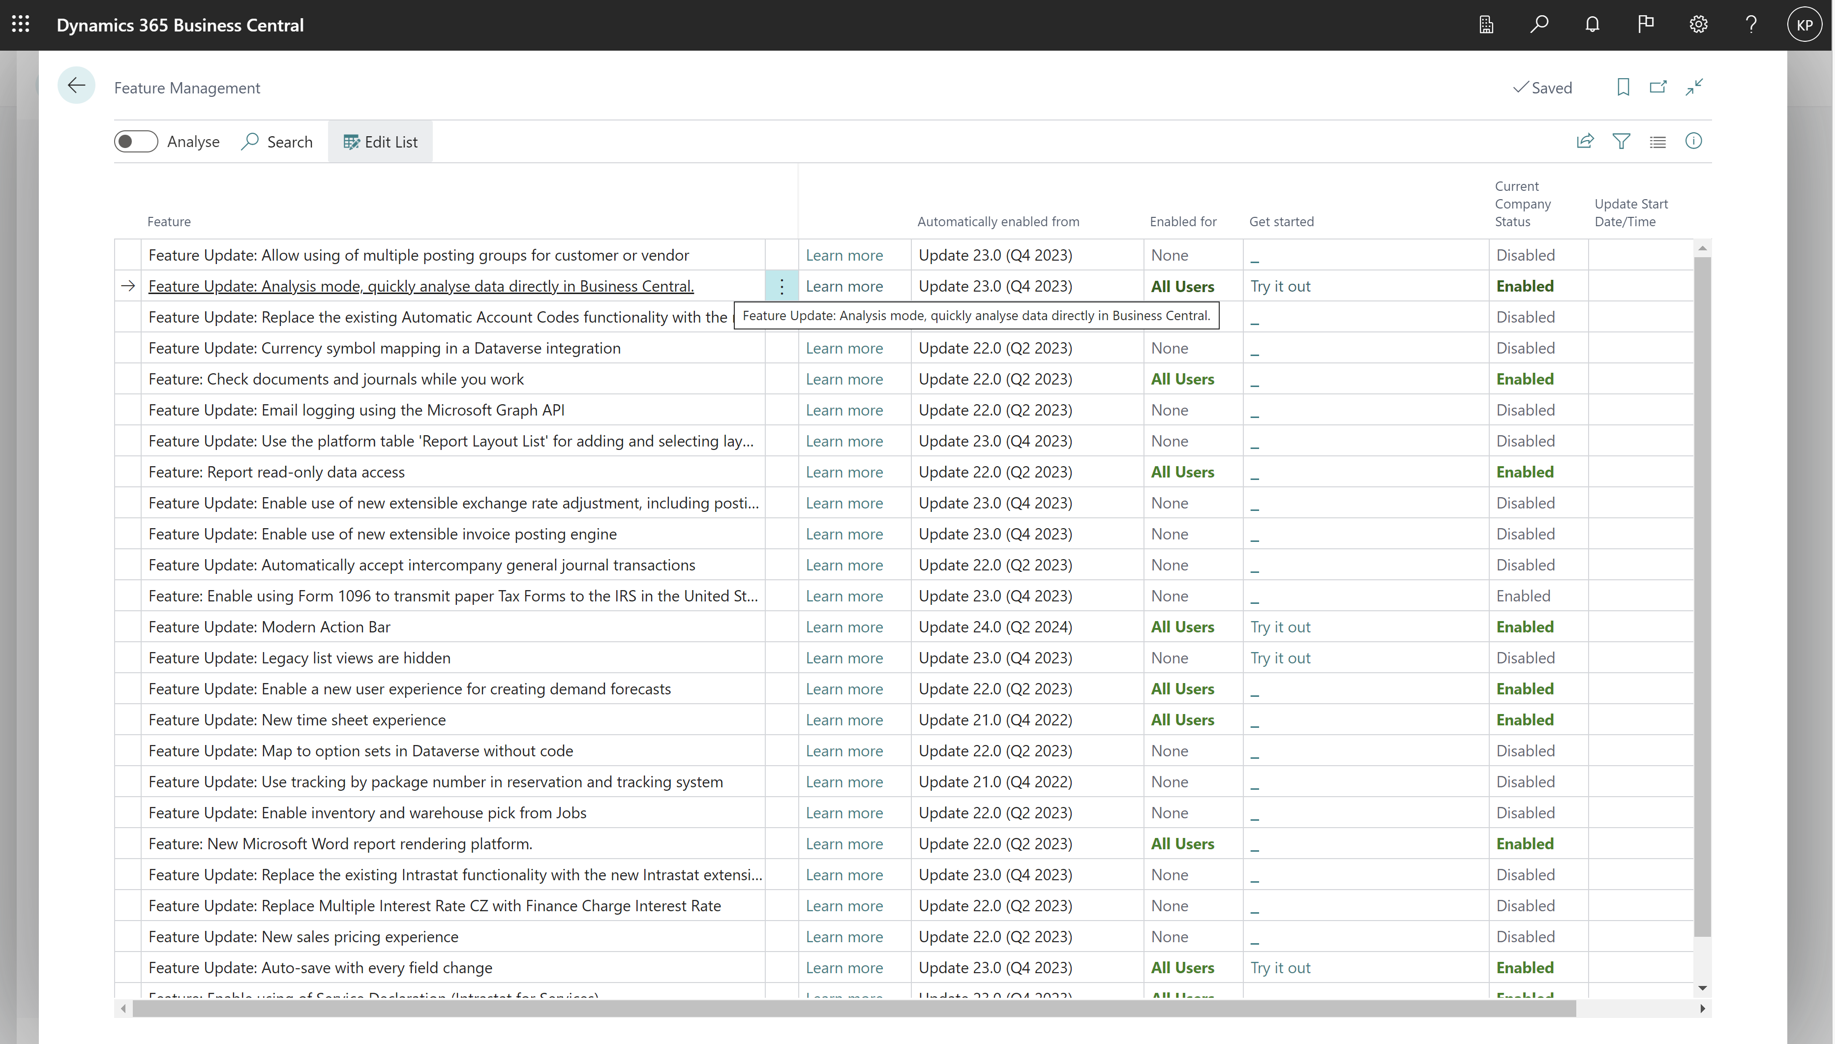
Enable under Feature Management

Slide 5
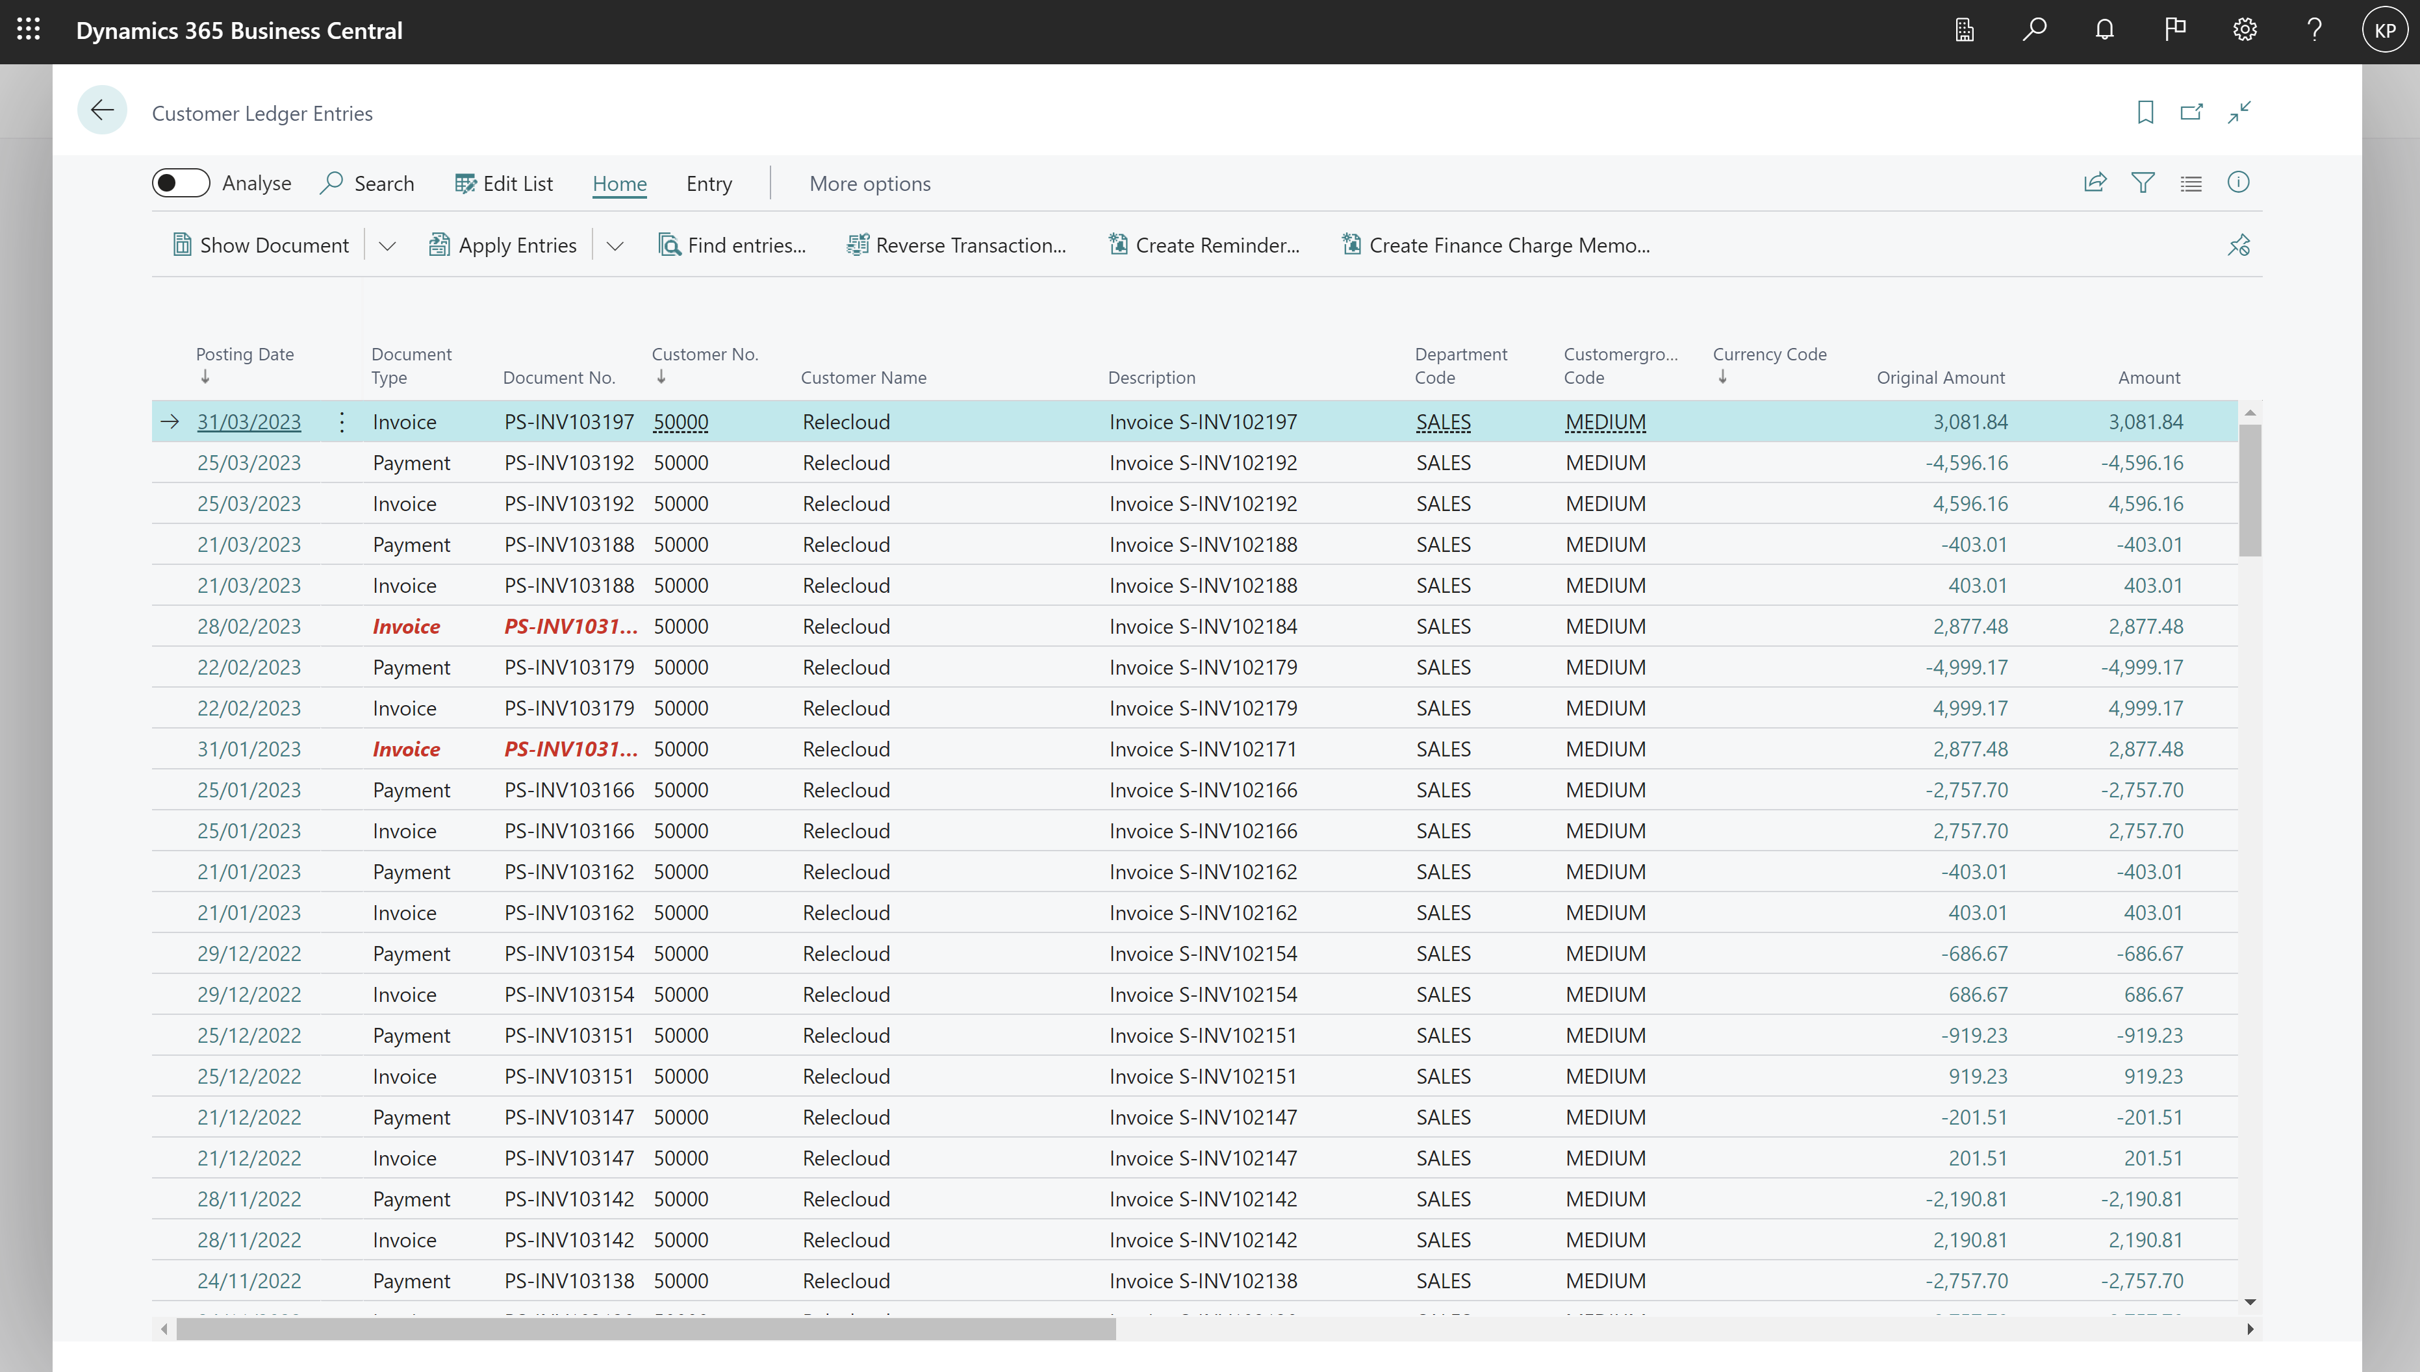
Go to Analysis Mode on a list page

Slide 6
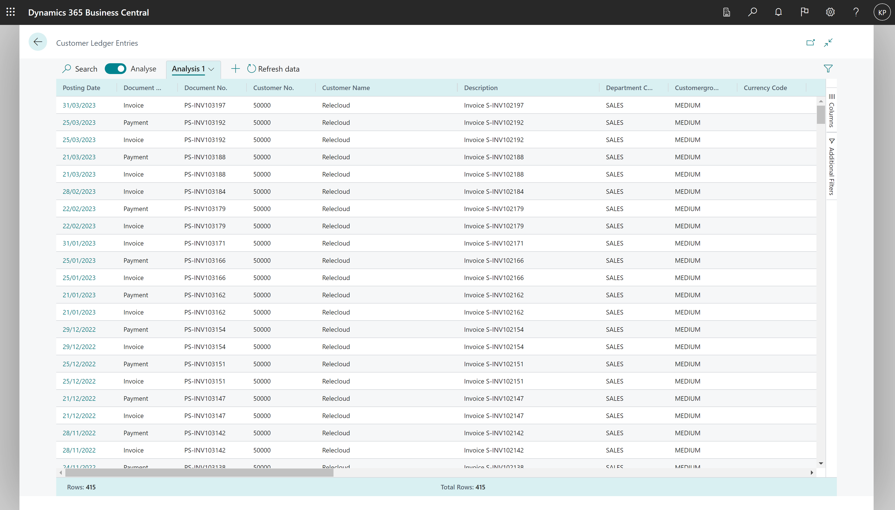
Opens the list with additional analysis capabilities

Slide 7
Page Areas in Analysis mode
Tabs pane
Field modifier area
Data area

Slide 8
Row count always shown on the bottom of the page

Slide 9
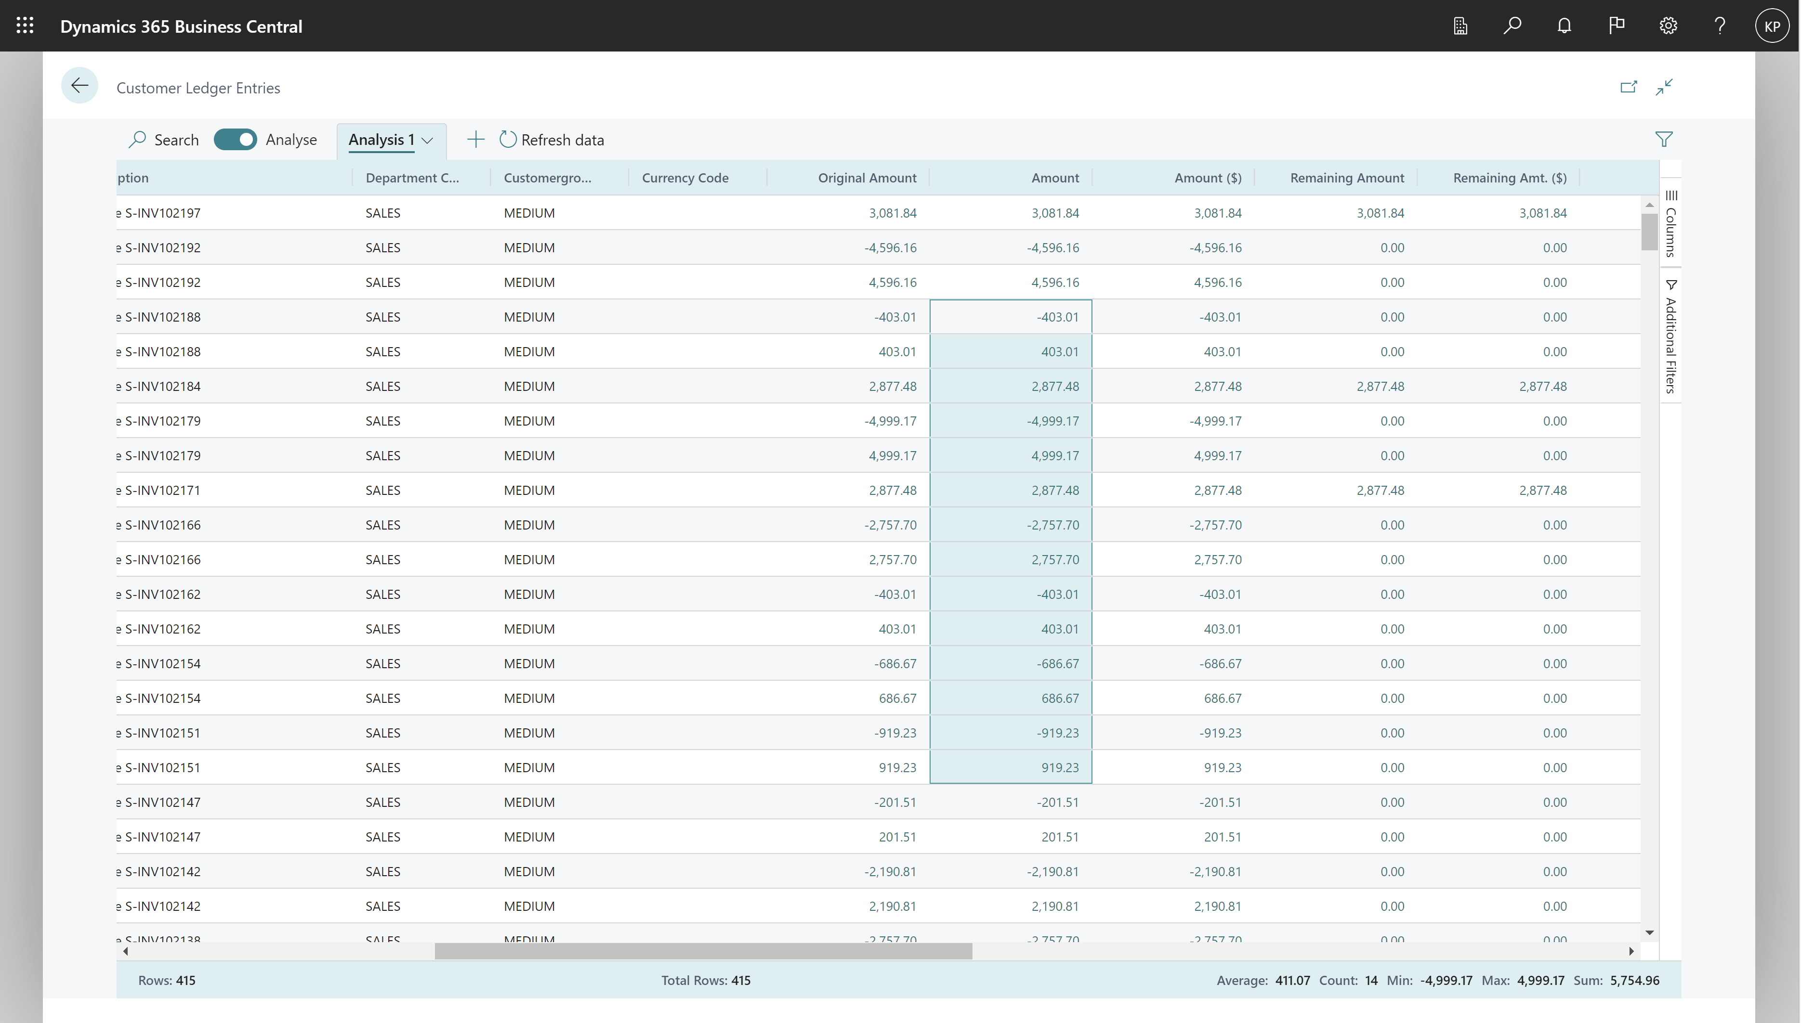
Mark cells for easy statistics

Slide 10
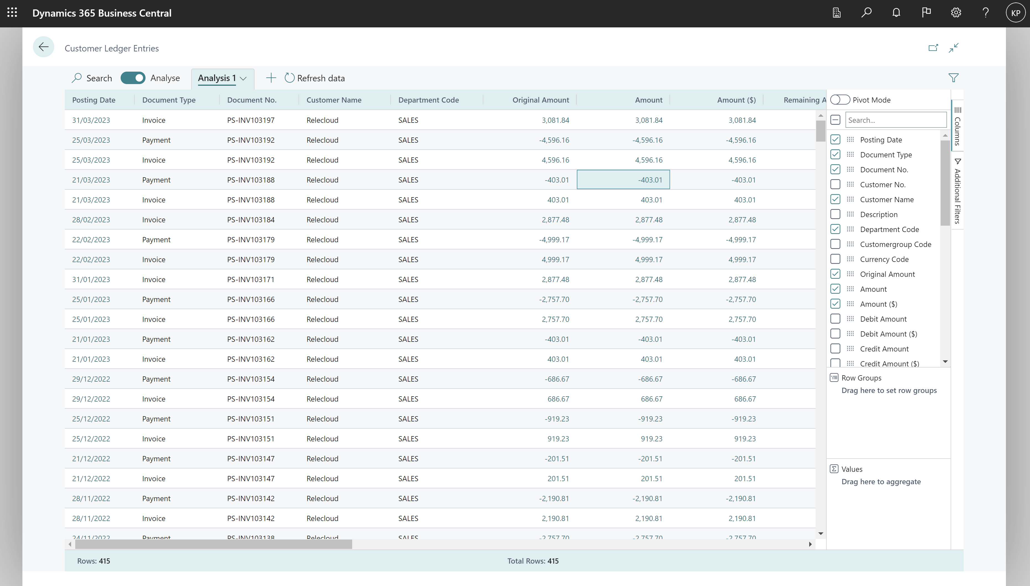
Choose which columns to show

Slide 11
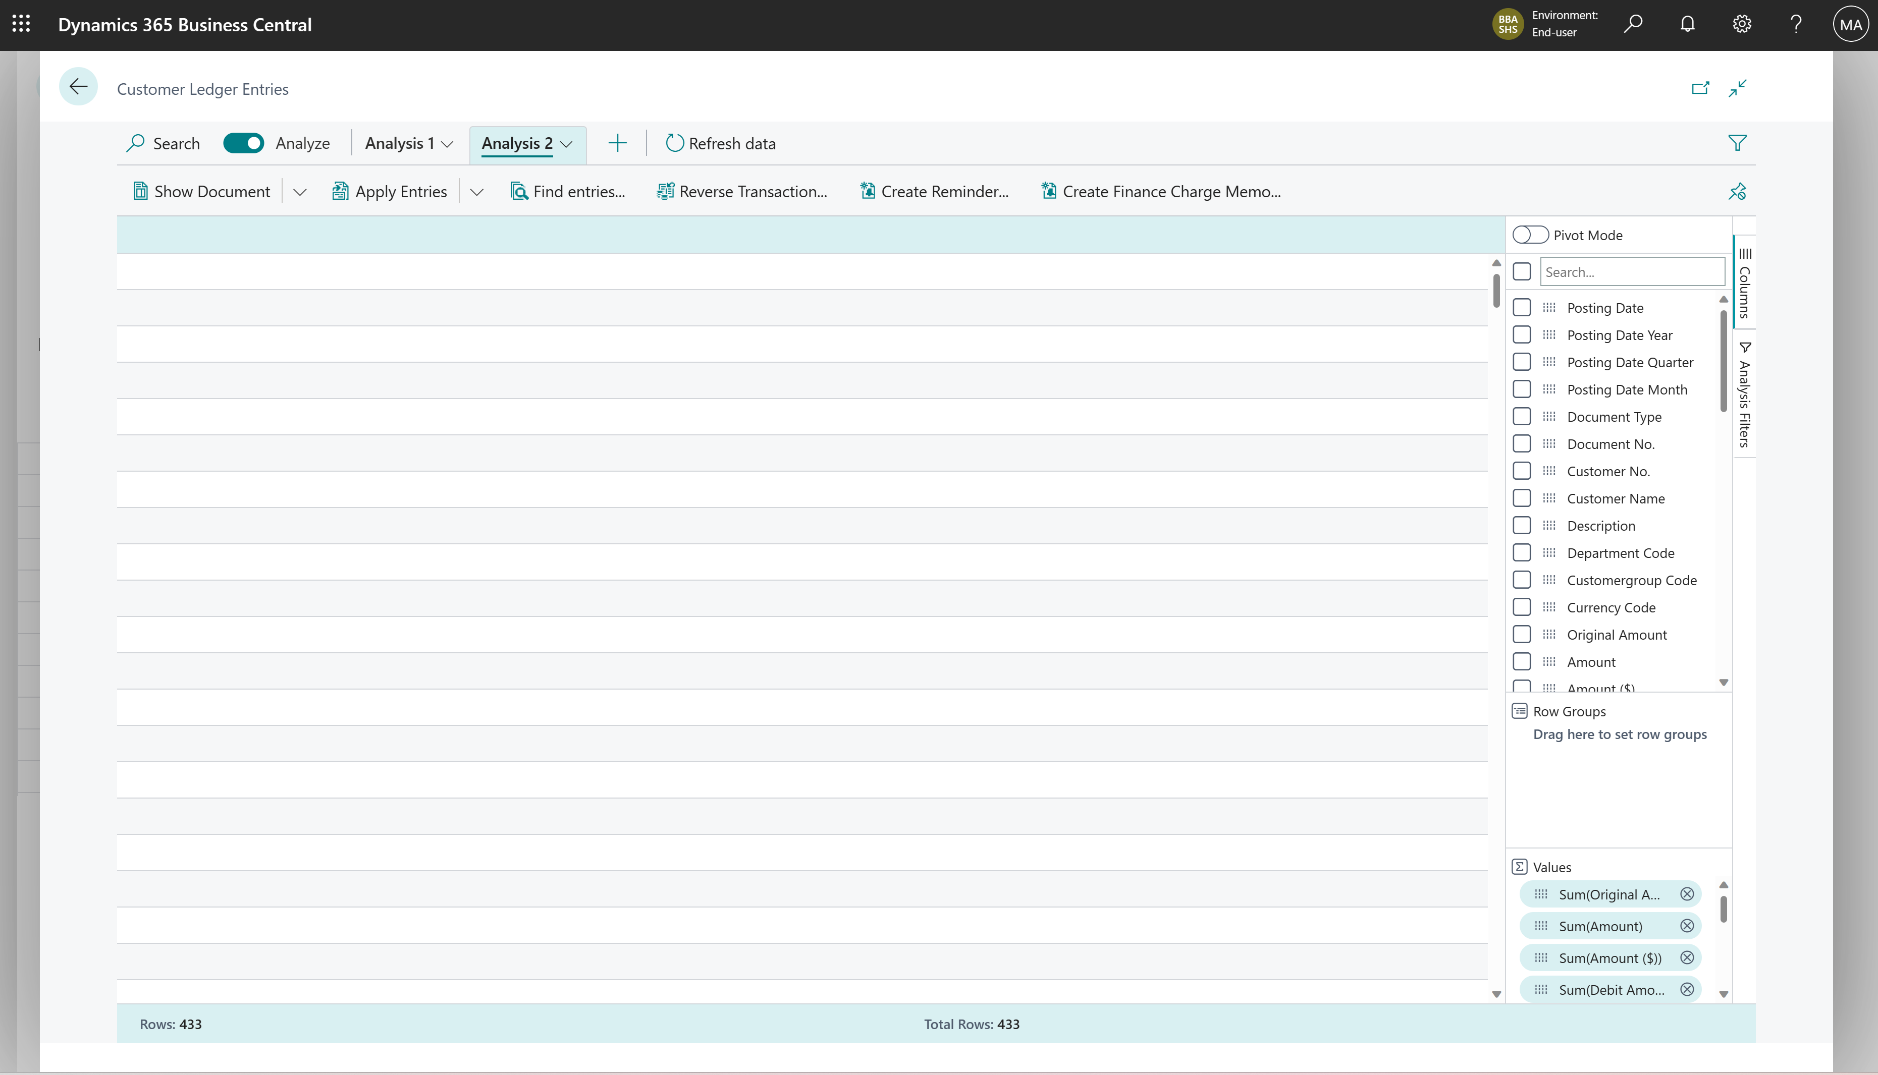
Clear all columns

Slide 12
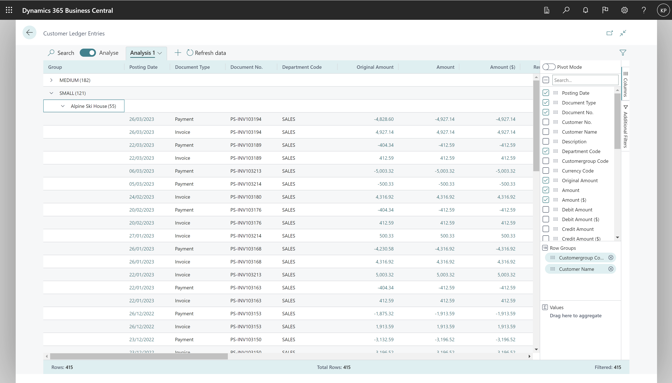
Group data by Row Groups

Slide 13
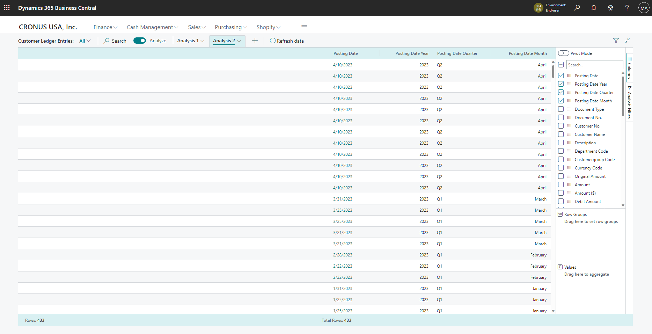
All date fields has a Year-Quarter-Month hierarchy

Slide 14
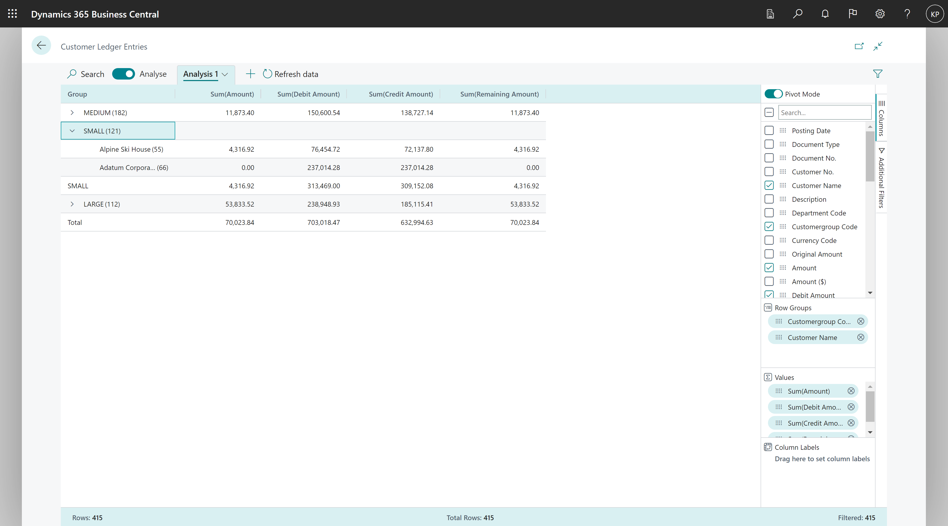
Pivot data by Row Groups

Slide 15
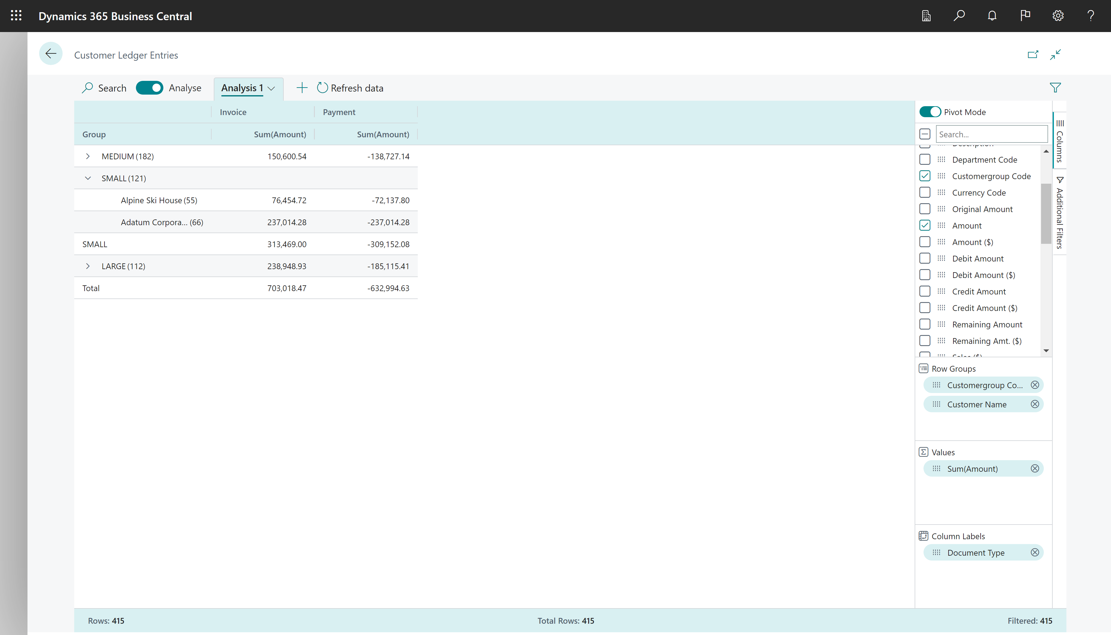
Pivot data by Row Groups and Column Labels

Slide 16
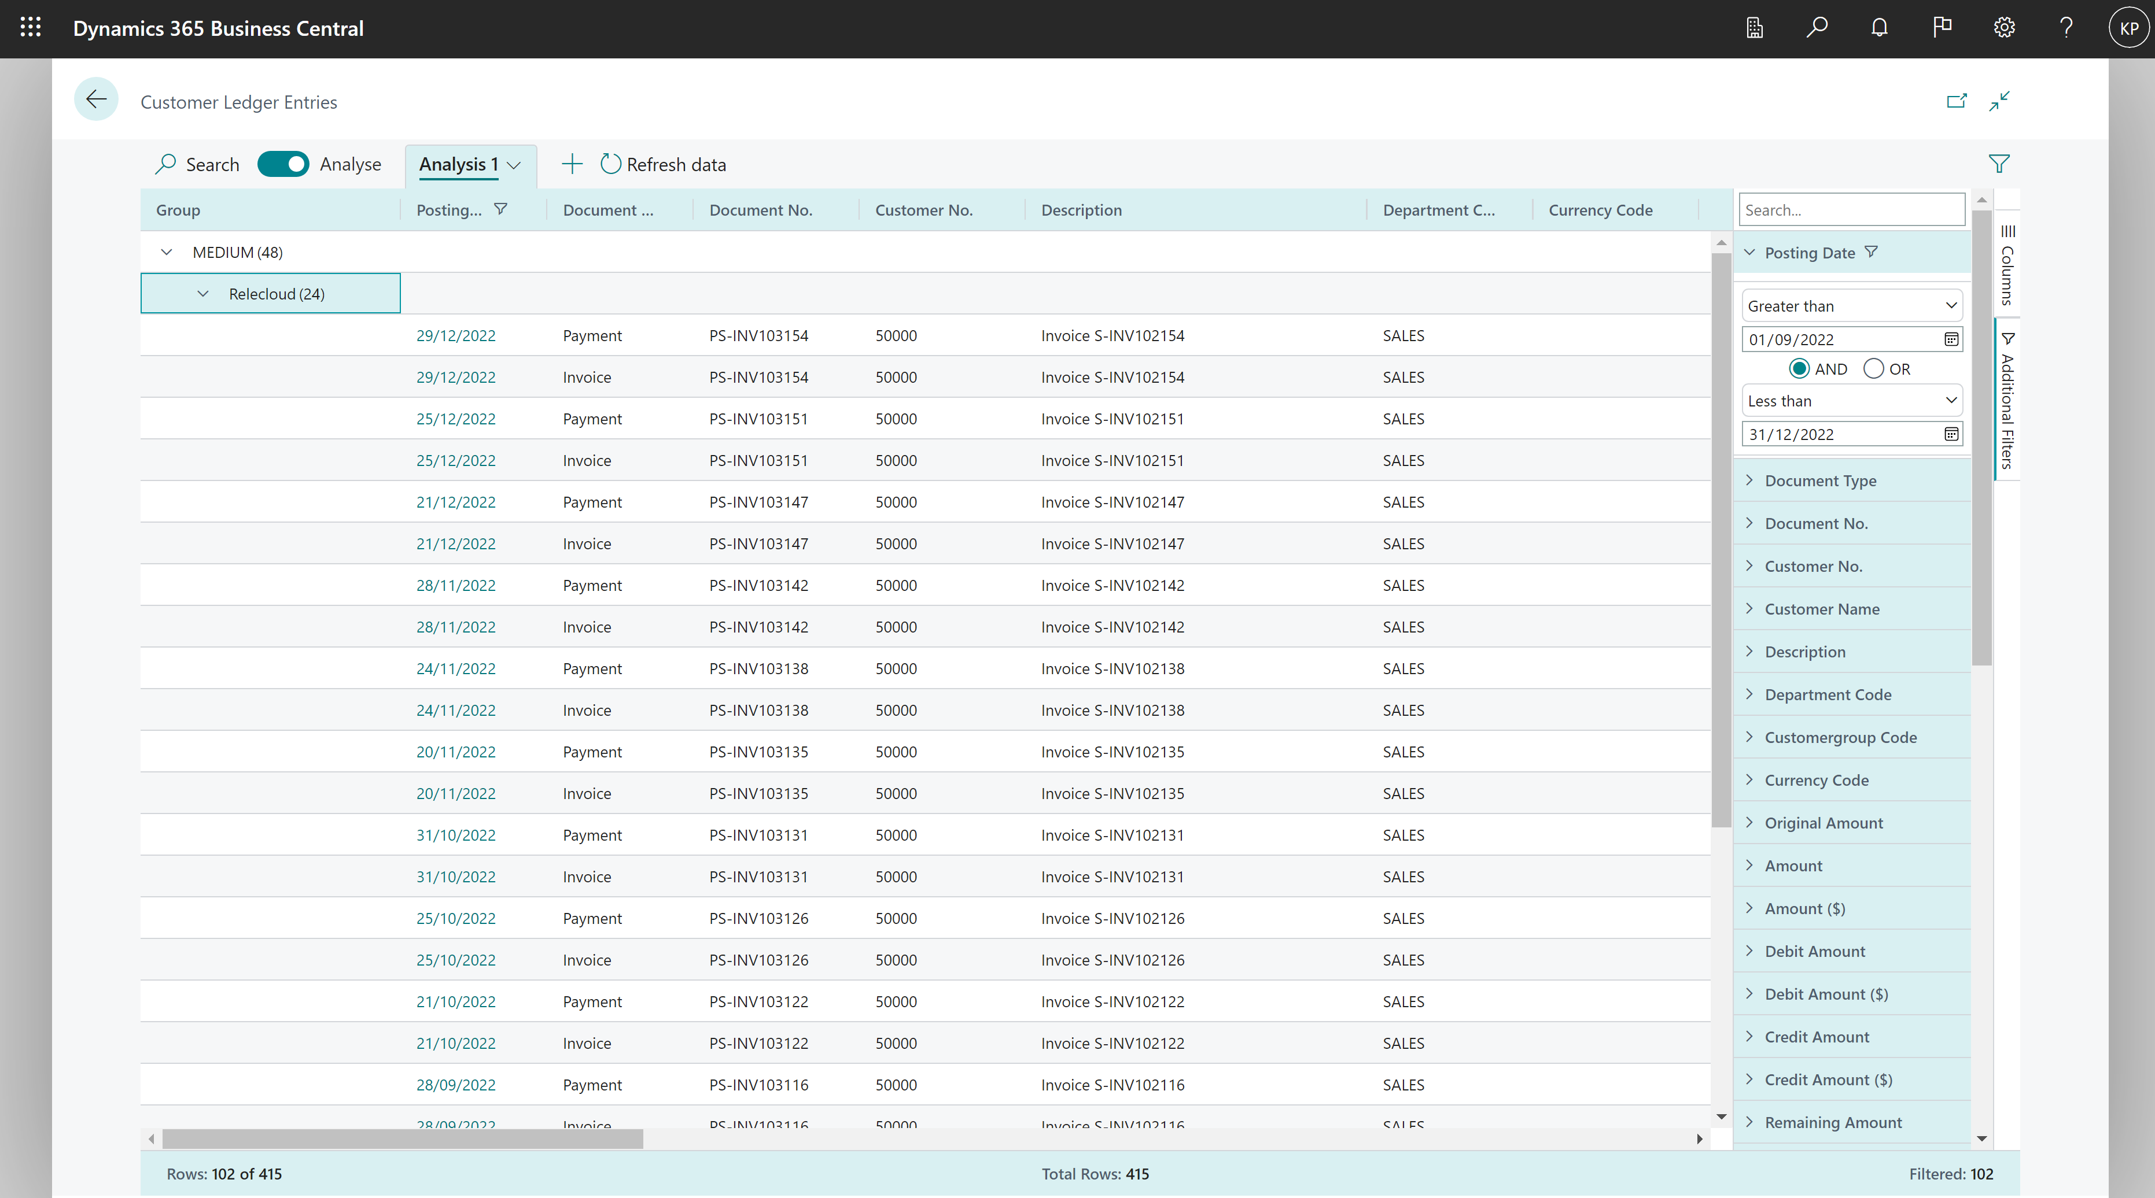
Set additional filters (local to the active tab)

Slide 17
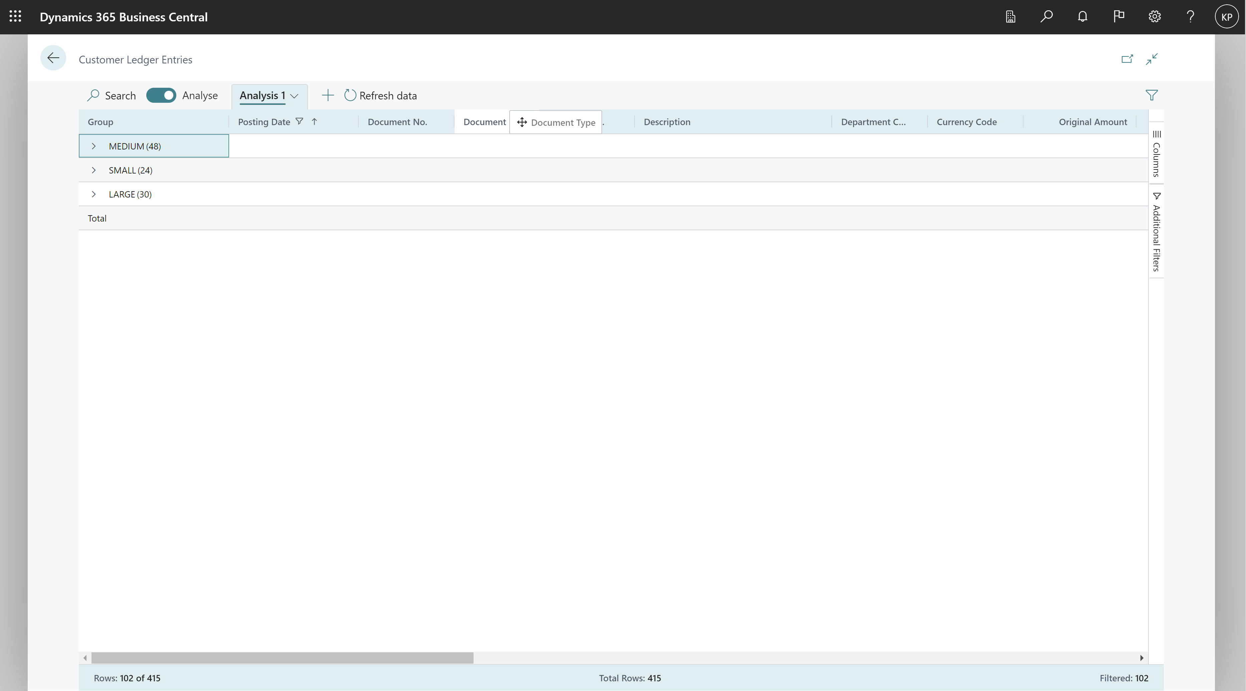
Drag and drop columns

Slide 18
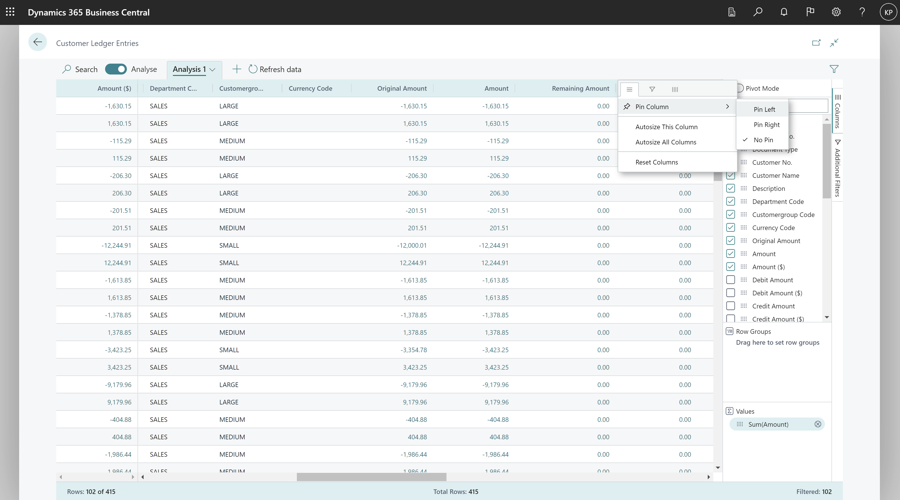
Pin columns (to left or right)

Slide 19
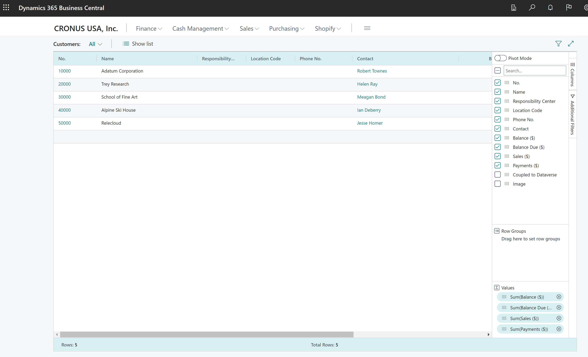
Peek to details or open card

Slide 20
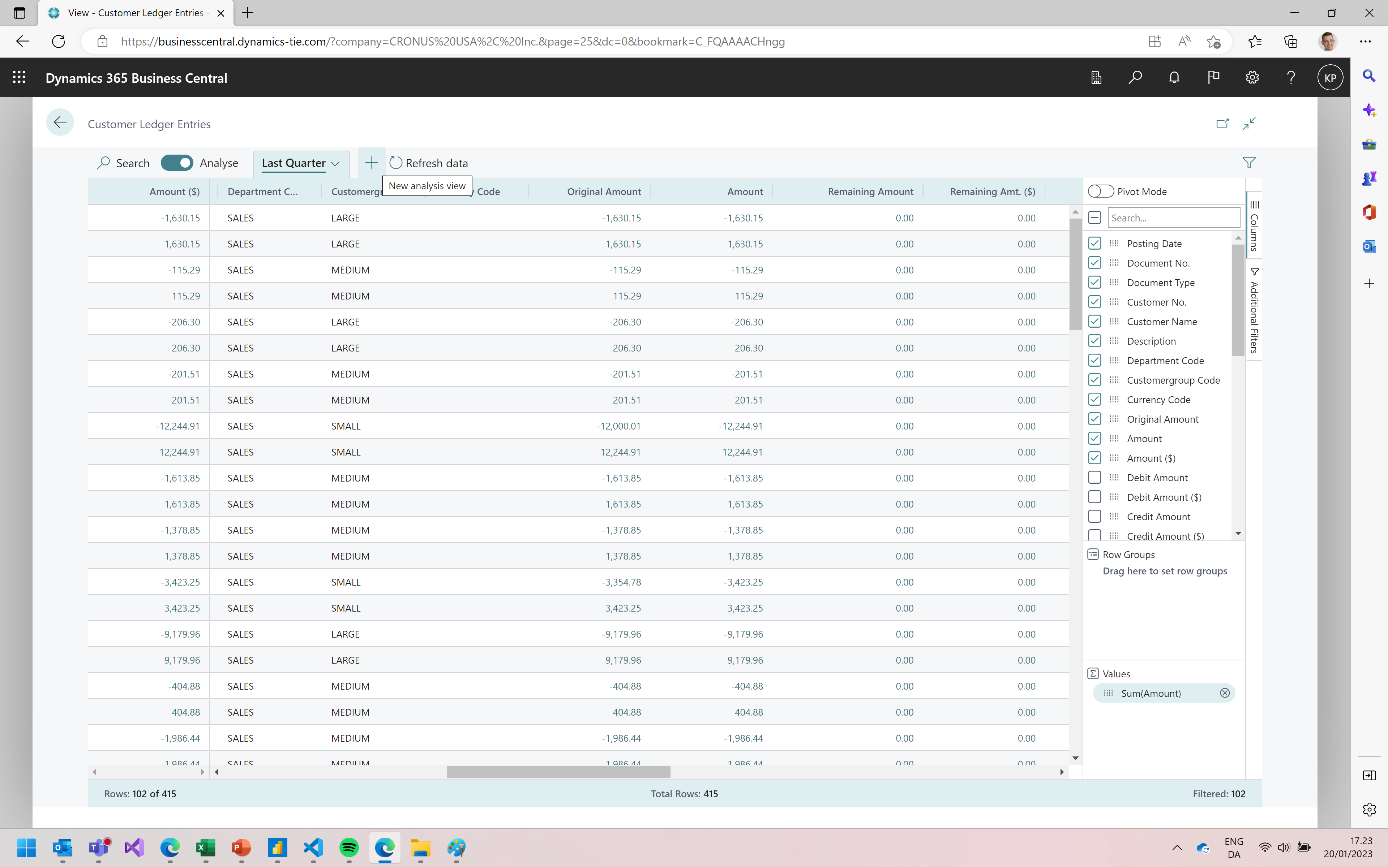
Add new tabs

Slide 21
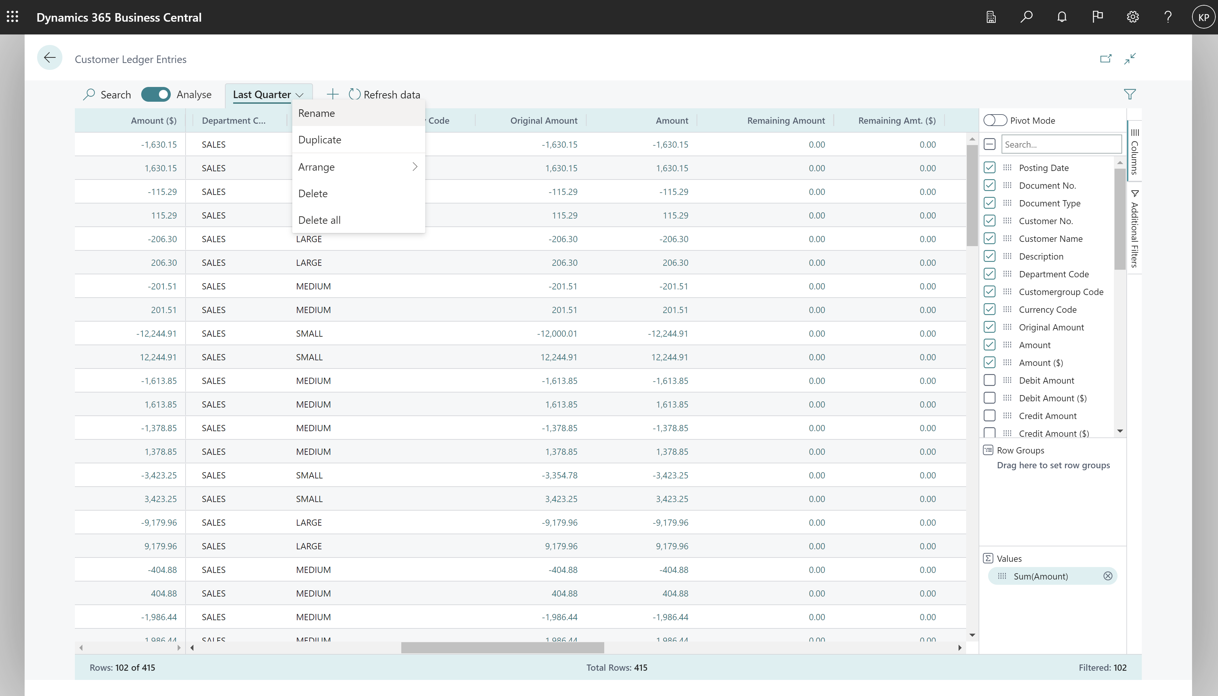
Rename (or copy or delete) tabs

Slide 22
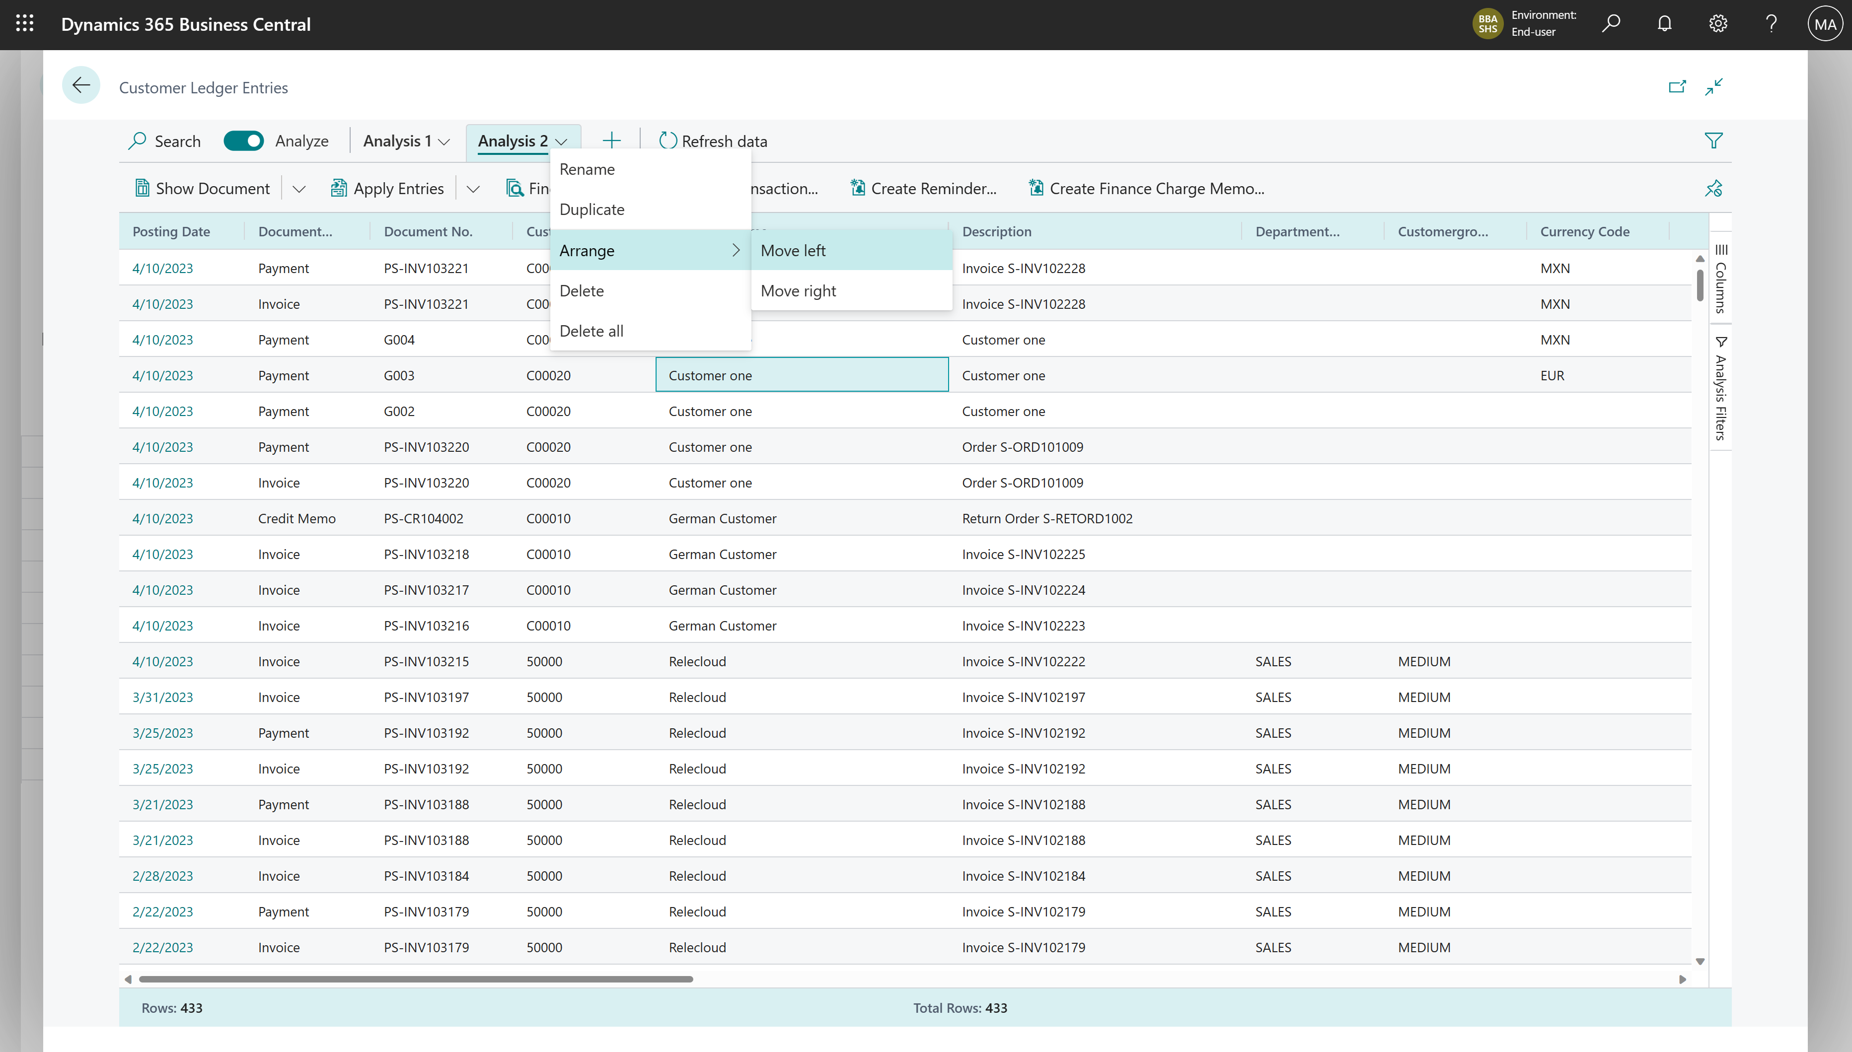
Arrange tabs

Slide 23
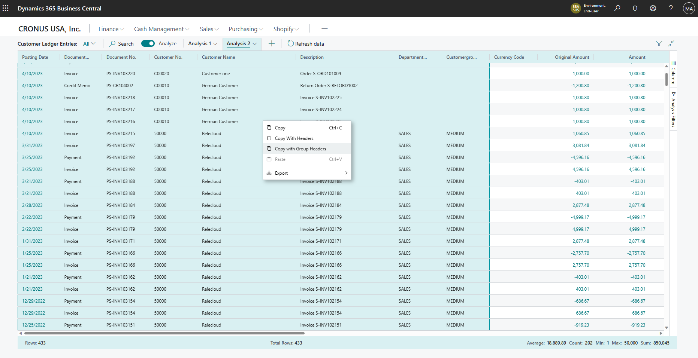
Mark data and copy (right-click on the data area)

Slide 24
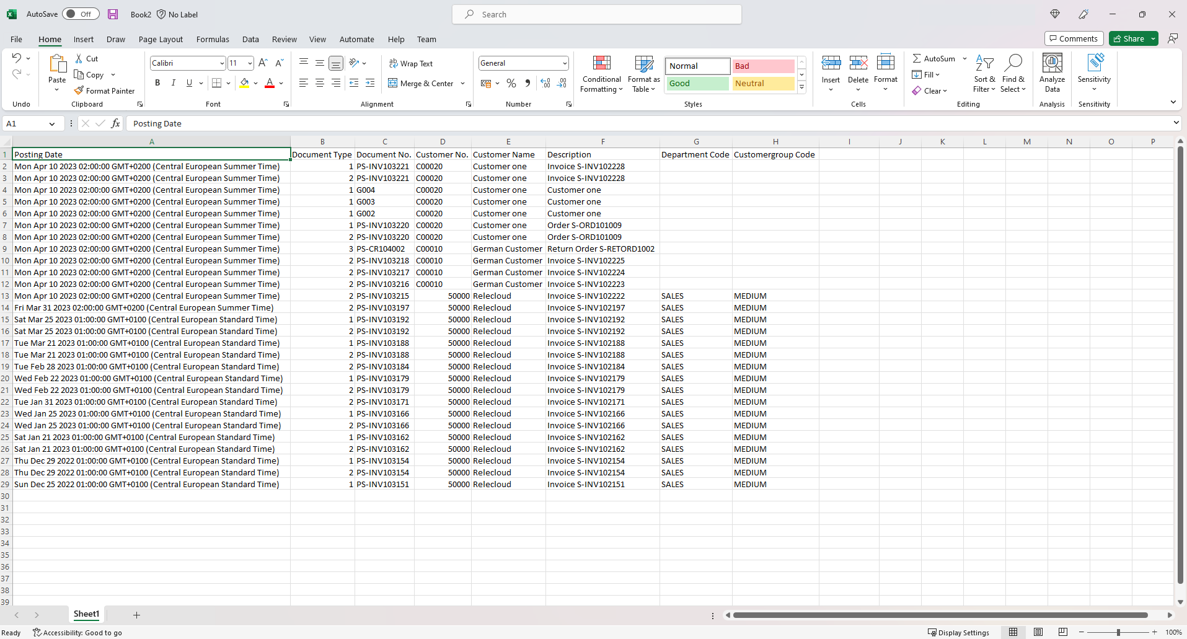
Mark data and copy (copy directly to Excel)

Slide 25
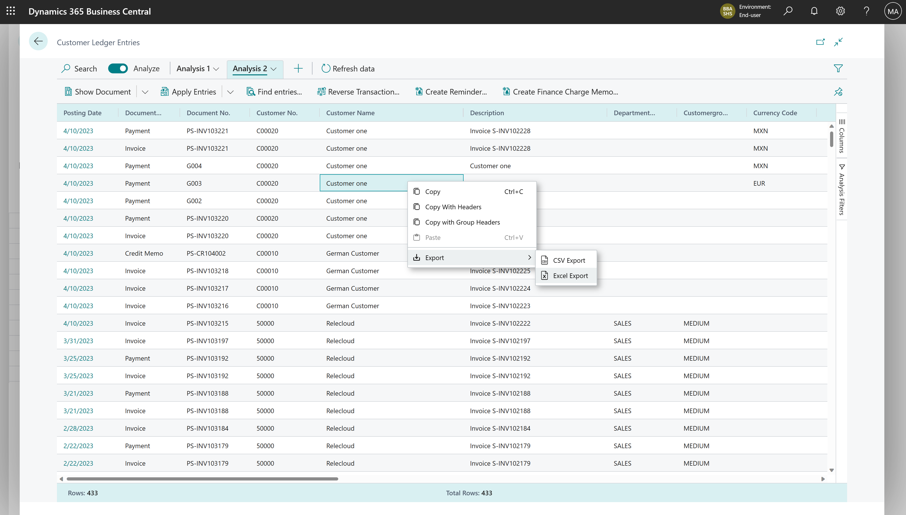
Export data (right-click on the data area)

Slide 26
Excited? We are!
Coming in public preview
Business Central
2023 release wave 1

